Slide 1




Profit Staffing
https://profit-staffing.com
https://www.instagram.com/profit_staffing/

Slide 2
Profit Staffing
Our history
Profit Staffing was founded in 2024 in the city of Denver, recognizing the market's need for both temporary employment opportunities and the hiring of specialized personnel for specific tasks or duties for companies.
We are focus on helping as many people as we can to find a good job for their good and their family.

Slide 3
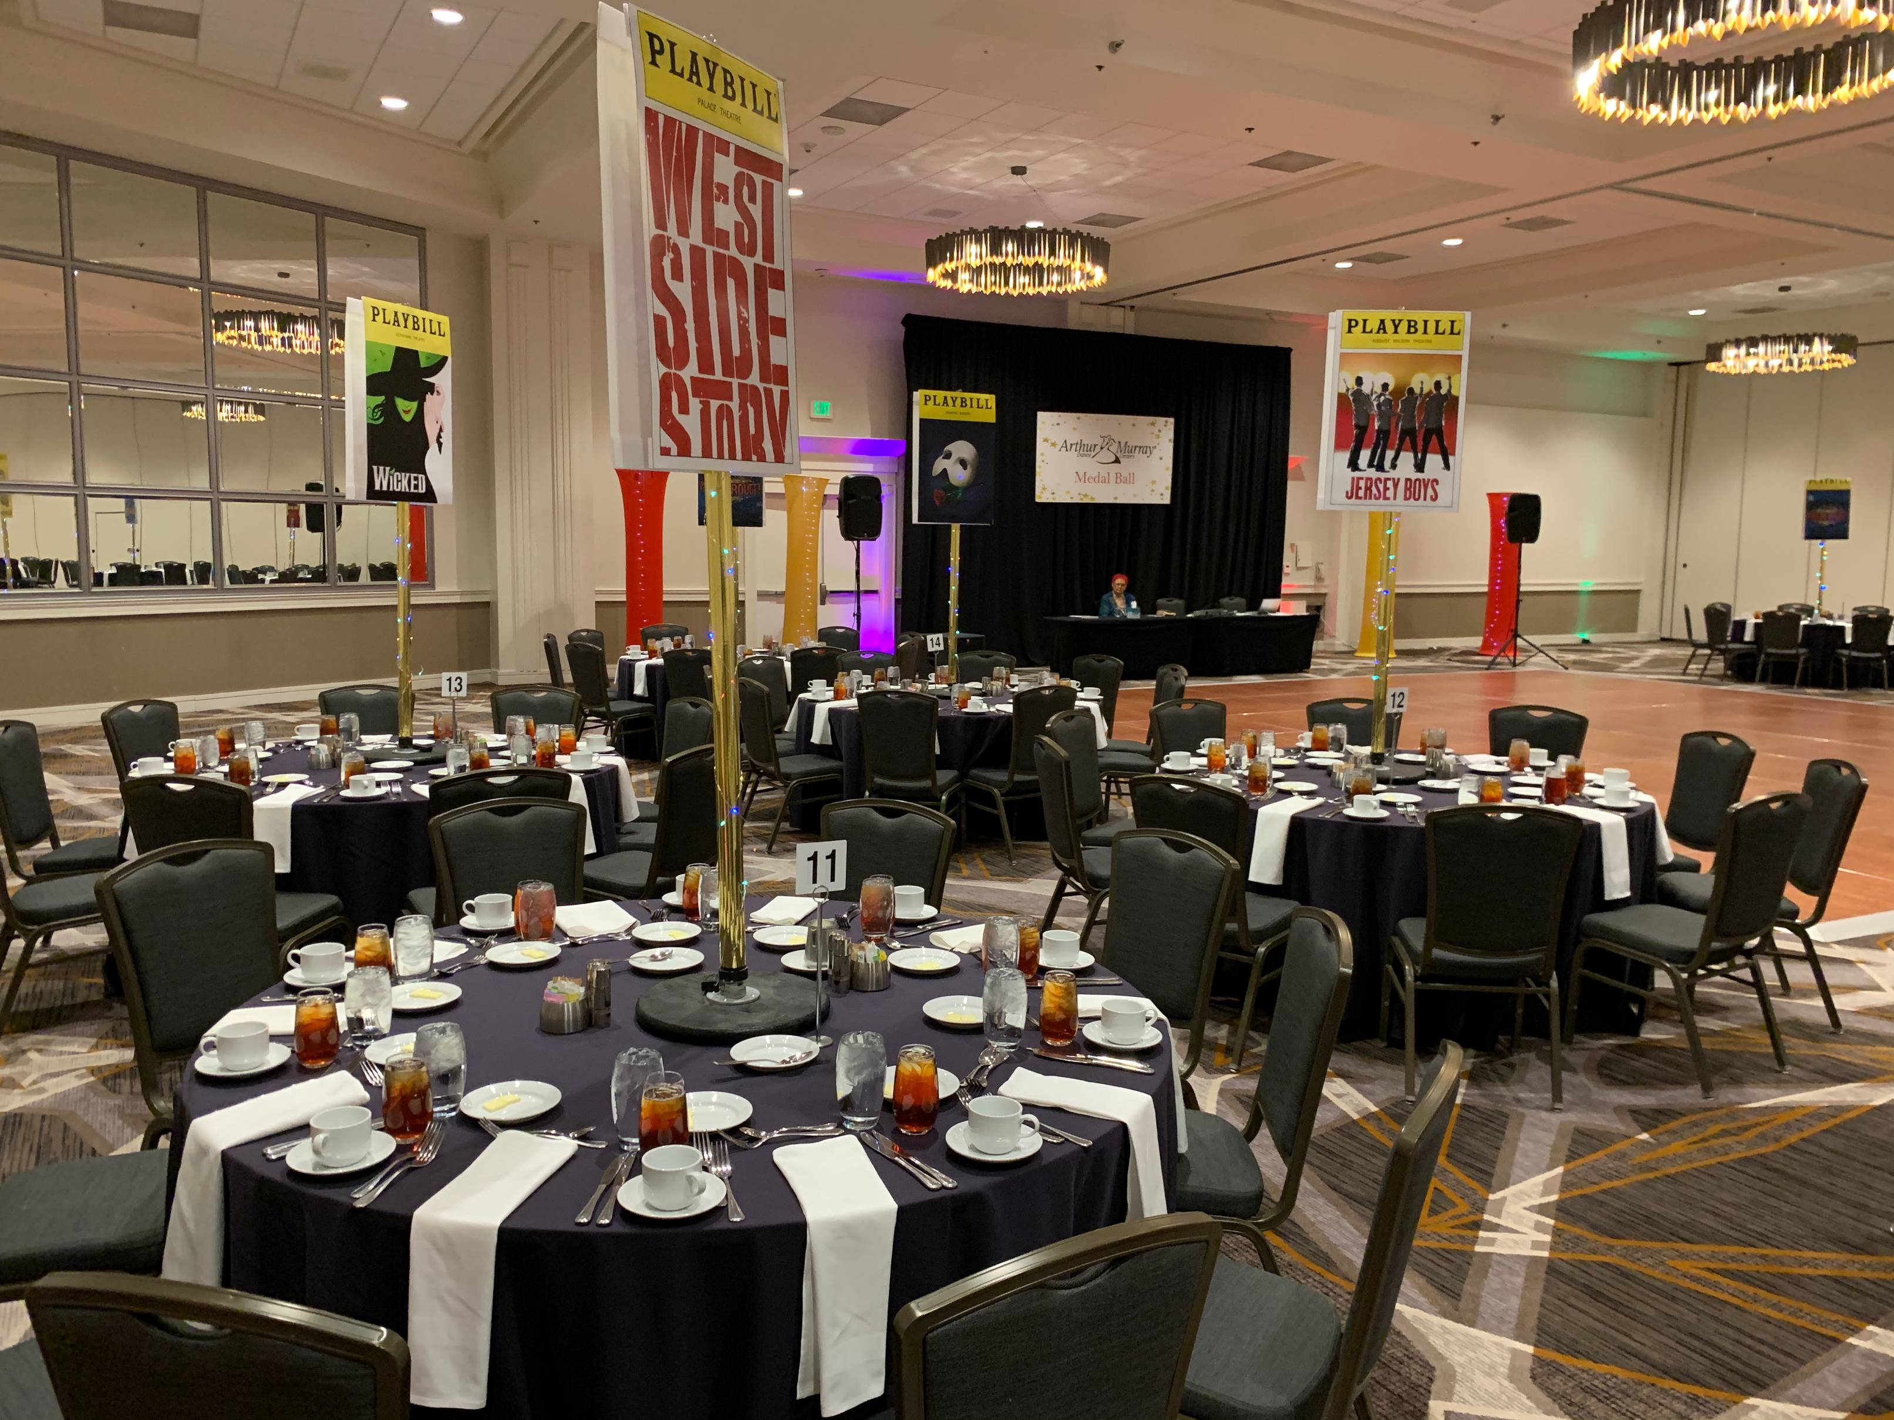
Profit Staffing
Mission
We are dedicated to meeting market needs by providing both temporary employment opportunities and specialized personnel for specific tasks.

Slide 4
Profit Staffing
Vision
We aspire to be leaders in providing staffing solutions in Denver, recognizing and responding to market needs by offering both temporary employment and specialized personnel.
We aim to simplify hiring processes for companies and eliminate complications associated with personnel management.

Slide 5









Profit Staffing
Borcelle Company
Our Values
Honesty
Excellence
Collaboration
Profesional
Goal oriented
Team work

Slide 6

Profit Staffing
Our Goals 2.024
For 2024, we hope to place at least 100 employees in various companies and different types of jobs by the end of the year, thereby creating many benefits for those individuals who are unable to find employment that matches their experience.
01
02
03
To get at least 10 people place in their jobs for the first month.
To create a web portal where such as Clients as Employees can access to see their profile, development and earnings
To have 100 personnel placed in different companies in Denver for December 2.024

Slide 7






Profit Staffing
Thank You!
Contact Us
Phone
(720) 688-5662
Mail
profittstaffing@gmail.com
Web
https://profit-staffing.com
https://www.instagram.com/profit_staffing/
Address
8000 E Evans Ave, Denver CO 80231

